Slide 1

PYTHON PBL Topic-
Text to Speech converter
SR. NO | NAME | ROLL NO. | PRN | OFFICAL EMAIL
1 | DEEP JADHAV | 7050 | 22010818 | deep.22010818@viit.ac.in
2 | ONKAR JAGTAP | 7055 | 22010898 | onkar.22010898@viit.ac.in
3 | DINESH RAUT | 7058 | 22010946 | dinesh.22010946@viit.ac.in
4 | VISHAL NAGRE | 7060 | 22010978 | vishal.22010978@viit.ac.in
5 | AKSHAY MISAL | 7064 | 22011042 | akshay.22011042@viit.ac.in
Guided by : Mrs. Aparna Barbadekar
Class: FY. BTech Division: G Batch: G3 GROUP NO :- 02

Slide 2
PS: To convert given text to speech by using different inputs in python programming language
Abstract
Text To Speech is an amazing and easily expandable project. We got to know another application of PyQt5.QtWidgets and various features of python and how it is practically used . We came across different module especially the “ PYTTSX3 / PyAudio ”.
This module converts scripts into audio.
We could also change the rate of speech , volume, and also the voice.

Slide 3
Pyqt5 brief introduction
PyQt5 is a comprehensive set of Python bindings for Qt v5.
It is implemented as more than 35 extension modules and enables Python to be used as an alternative application development language to C++ on all supported platforms including iOS and Android.

Slide 4
Features of TTS
Simple Home Page with Text Box Different Buttons used to convert different types of text to speech and vice versa.
Translation of text to desired language available
Speech to text is also possible Pdf to Speech is another option for fast conversion

Slide 5
Future Scope
People are increasingly mobile and looking for convenience –A growing share of time spent on digital content is on mobile devices the demand for connected devices continues to rise on a worldwide scale. Text to speech can turn any digital content into a multimedia experience and people can listen to a news or blog article, a PDF document, or an e-book on the go. Extend the reach of your content – TTS gives access to your content to a greater population, such as those with literacy difficulties, learning disabilities, reduced vision and those learning a language.
Enhanced employee performance with corporate learning programs – With TTS technology, HR departments and e-learning professionals can make learning modules and employee training much easier for employees to learn anywhere and at anytime.

Slide 6
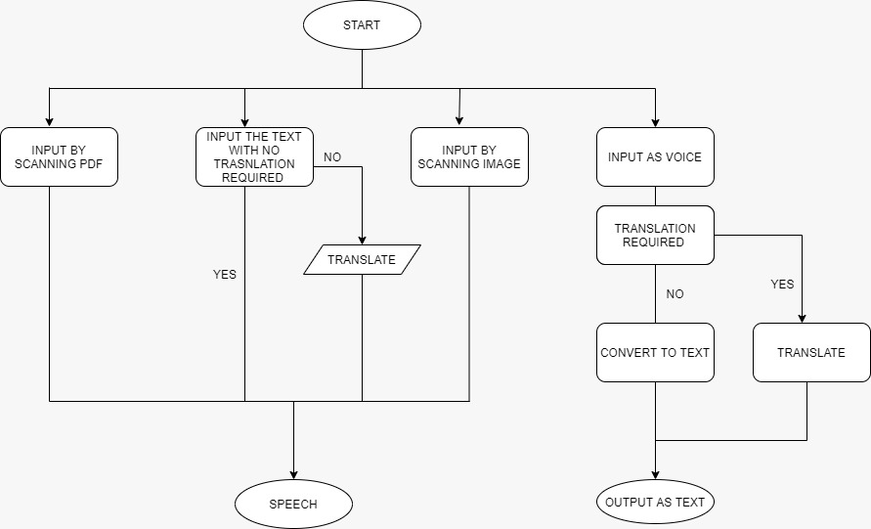
FLOW OF PROGRAM

Slide 7
List Of The Topics/ Concept Which Are Covered From The Syllabus
User defined functions.
Declaration of Variables.

Slide 8
List Of The Topics/ Concept Which Are Out Of Syllabus
Importing various modules are as follows :-
PyQt5
PyPDF2
PYTTSX3
speech recognition
Python Imaging Library (PIL)
Pytesseract
pyaudio
gTTS

Slide 9
Conclusion
In the conclusion of this project, we would like to say that Python is a fun and easy programming language and while creating a project like this, it has not just been a good experience but it also helped in the development of our creativity and logical thinking.
We would be more than happy to work on other projects in Python because it’s just amazing to work with Python

Slide 10
Work distribution
1. 7050_Deep jadhav :
by using pYqt5 module graphical user interphase with the push buttons and text box as input for text
By using pypdf2 module pdf to speech feature
By using pyttsx3 module speech to text feature
2. 7055_Onkar Jagtap:
Unrecognizable sound detection
3. 7058_dinesh raut
By using the modules pyaudio and speech recognition make the feature of audio to text
4. 7064_Akshay Misal
By using the module of gtts make the translation features to the respective inputs
5. 7060_Vishal Nagre
By using pytesseract module make the featured of scan to speech

Slide 11
THANK YOU

